Slide 1


Predicting Debt Recovery Probability through Statute-Barred Analysis
By : RASHMITA MAHAPATRA

Slide 2


TABLE OF CONTENT
INTRODUCTION
BUSINESS PROBLEM
OBJECTIVE
DATA OVERVIEW
EDA
DATA PREPROCESSING
MODEL SELECTION
MODEL TRAINING
HYPER PARAMETER TUNING
MODEL TESTING
MODEL EVALUATION
FEATURE IMPORTANCE
CONCLUSION

Slide 3

INTRODUCTION
Effective debt collection is a critical function for financial institutions and creditors. Timely and efficient debt recovery can significantly impact their bottom line and reduce operational costs.
In this session, we will explore how machine learning can transform debt collection processes by predicting the probability of successfully collecting debts through meticulous analysis of the "Statute-Barred" status.

Slide 4
Objectives
BUSINESS PROBLEM
Debt collection is a critical part of many businesses and financial institutions.
It can be a complex and often challenging task. There are various factors that can affect the success of debt collection efforts.
One crucial factor is the legal status of the debt. Debts that are "statute-barred" are those for which the legal time limit for collection has expired.
The challenge lies in identifying which accounts fall into the statute-barred category. This is where data analysis and machine learning can play a crucial role.

Slide 5

OBJECTIVE
The primary objective of this project is to leverage advanced machine learning techniques to enhance the effectiveness of debt collection efforts.
The central focus of the project is the "IsStatBarred" field, which serves as the pivotal target variable for classification. The goal is to classify accounts as statute-barred or not based on predictive features.

Slide 6
Dataset Overview
DATASET OVERVIEW
Dataset Description
The dataset consists of :
To tackle the challenge of debt collection, we have collected a wealth of valuable data.
This dataset is like a treasure trove of information that can help us make better decisions.
This data will serve as the foundation for our machine learning project.
The dataset comprises various attributes crucial for debt collection analysis, including creditor information, account IDs, current balances, purchase dates, and other pertinent features.
By carefully analyzing and understanding this data, we can uncover patterns and relationships that will guide our debt collection strategy.

Slide 7
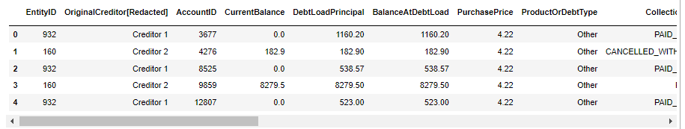
Exploratory Data Analysis
EXPLORATORY DATA ANALYSIS
The first step in solving any case study in data science is to analyze the data you have. It helps to give a valuable understanding of the pattern and information. EDA has a big role in the proper visualization of the data. Proper EDA gives interesting features to your data which in turn affects our data preprocessing and model selection criterion as well.
Let’s have a look at the data:
This dataset has 406423, data points and 26 features along with their target label. The first 5 rows appeared as shown above.

Slide 8
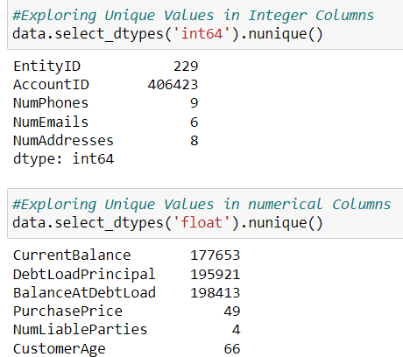
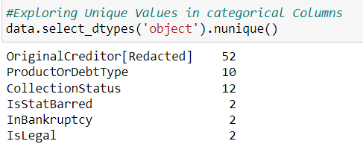
Exploratory Data Analysis
EXPLORATORY DATA ANALYSIS
Exploring Unique Values in categorical Columns
Exploring Unique Values in numeric Columns

Slide 9
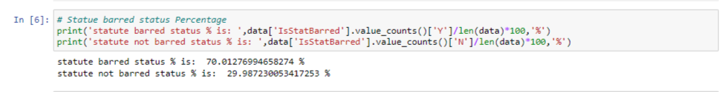
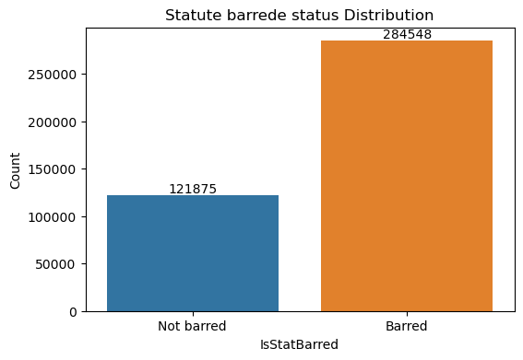
Exploratory Data Analysis
EXPLORATORY DATA ANALYSIS
Distribution of classes
The output indicates that approximately 70% of the records correspond to Statute barred status, while about 30% correspond to statute not barred status in the dataset and Statute barred status is higher than Statute not barred status.

Slide 10
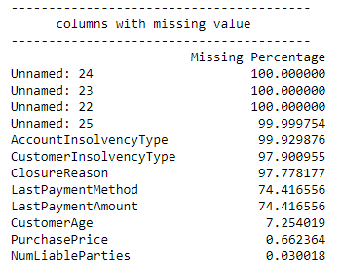
Exploratory Data Analysis
EXPLORATORY DATA ANALYSIS
Missing values
The Unnamed: 24,Unnamed: 23,Unnamed: 22,Unnamed: 25,AccountInsolvencyType,CustomerInsolvencyType,LastPaymentMethod, LastPaymentAmount, ClosureReason variables have more than 70% of missing values.
We can just drop these off. These variables are insufficient so its best to remove it completely from the data to avoid inaccuracies in the modeling.
customerage, purchase price,numliableparties variables have less than 8% of missing values.we can impute mean and mode values inplace of missing values.

Slide 11
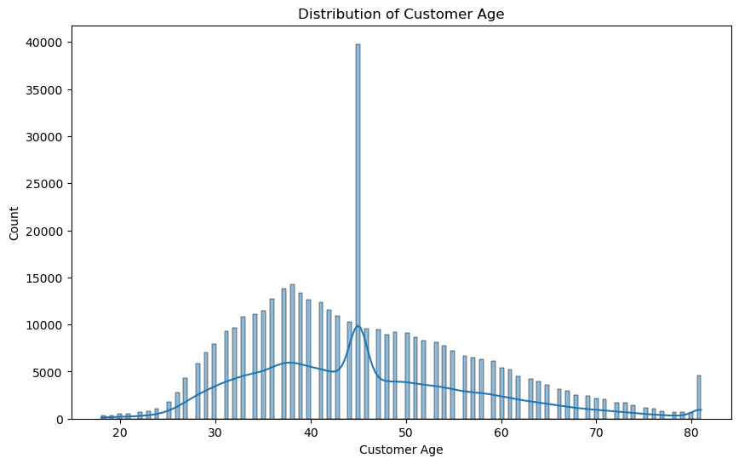
Exploratory Data Analysis
EXPLORATORY DATA ANALYSIS
after treating outliers we see that there are some age values of below 18. As per indian law below 18 age people cannot enter into aggrements.so we impute below 18 values with mean.
The youngest customer in the dataset is 18 years old.
The mean (average) age of customers is approximately 45.66 years. It's very close to the mean, indicating a roughly symmetric distribution.and we can see count for age 45 is high.
The majority of customers are between 37 and 53 years old.

Slide 12
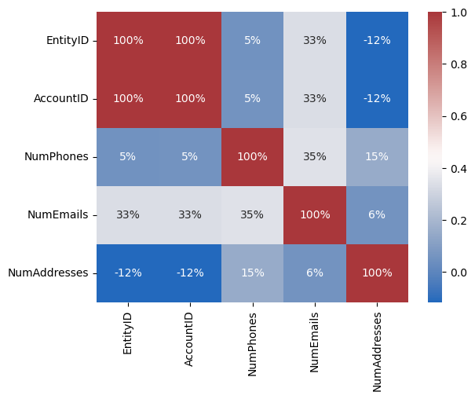
Exploratory Data Analysis
EXPLORATORY DATA ANALYSIS
Correlation of numeric features
from the above Correlation Heatmap we can see that entityid and accountid are highly negatively correlated to each other.Hence we can drop one of this features.here we are dropping accountid.

Slide 13
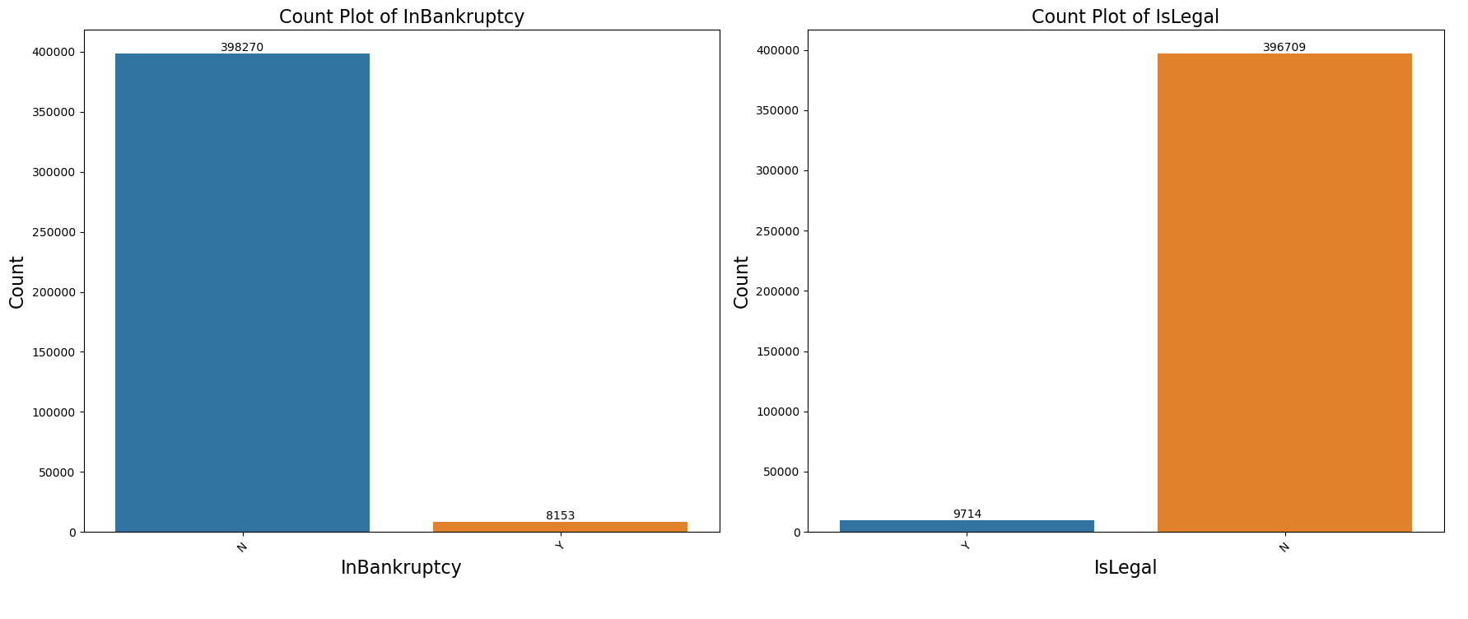
Exploratory Data Analysis
EXPLORATORY DATA ANALYSIS
In the 'InBankruptcy' and 'IsLegal' columns, the majority of entities are labeled as 'N,' meaning they are not in bankruptcy or do not have legal issues.

Slide 14
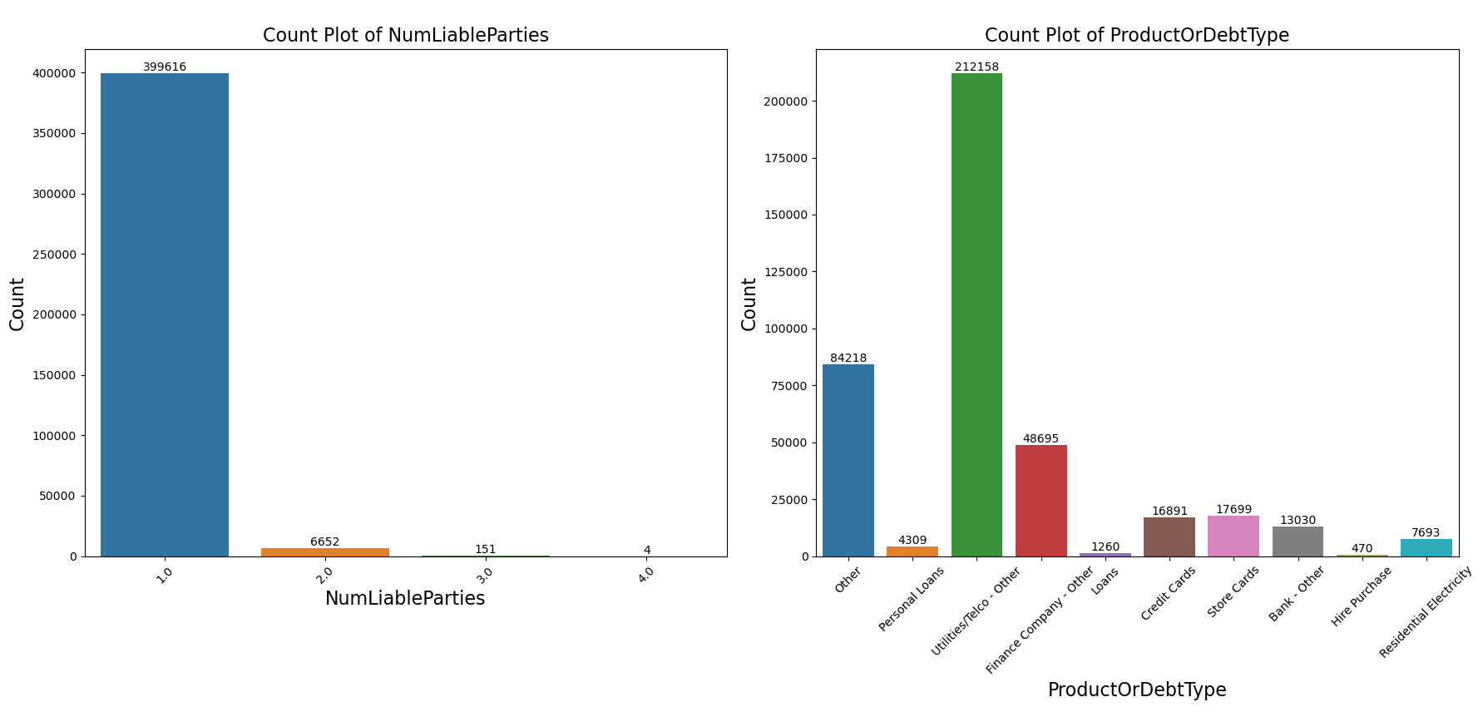
Exploratory Data Analysis
EXPLORATORY DATA ANALYSIS
NumLiableParties: It shows that most entities have no liable parties, with a few having a larger number of liable parties.
ProductOrDebtType: The majority of entities seem to fall into the 'Other,' and 'Utilities/Telco - Other' categories.

Slide 15
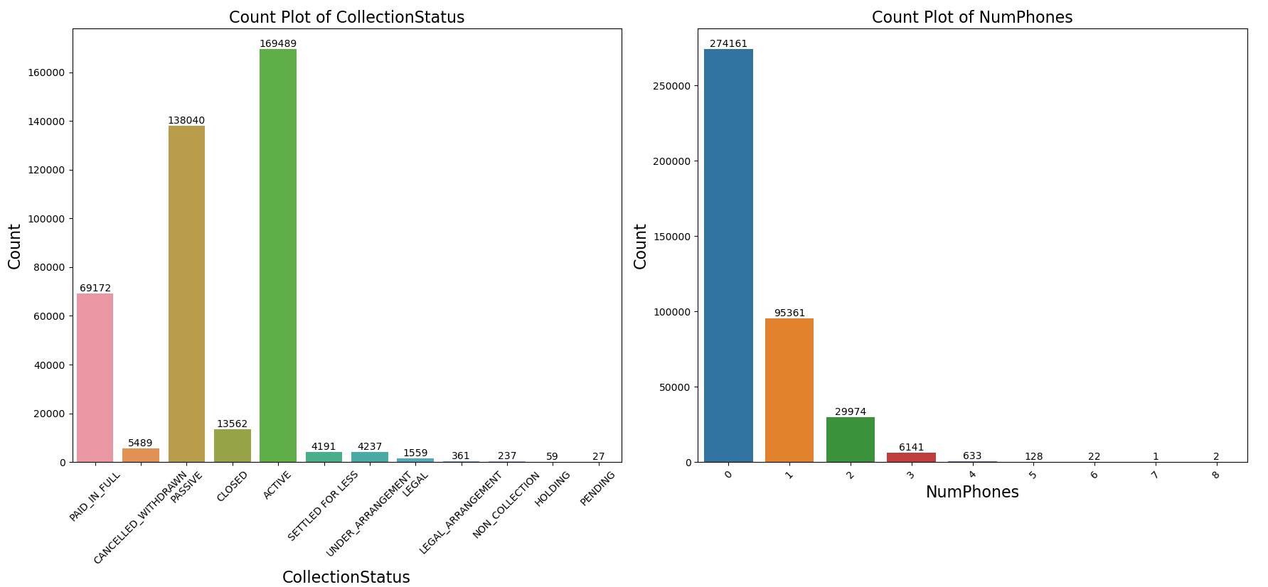
Exploratory Data Analysis
EXPLORATORY DATA ANALYSIS
Most entities in the 'CollectionStatus' column fall into the 'ACTIVE' and 'PAID_IN_FULL' categories, indicating a significant number of active and previously paid debts.
NumPhones: Similar to email contacts, most entities have no or very few phone contacts.

Slide 16
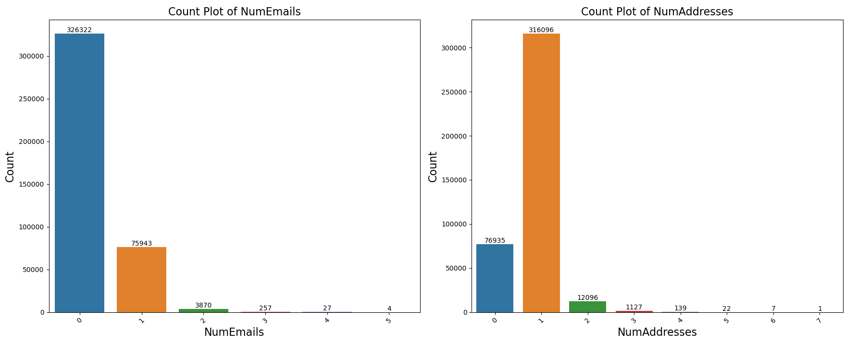
Exploratory Data Analysis
EXPLORATORY DATA ANALYSIS
NumAddresses: The majority of entities have 0 or 1 address, with very few having more addresses.
NumEmails: The majority of entities have no or 1 email contacts.

Slide 17
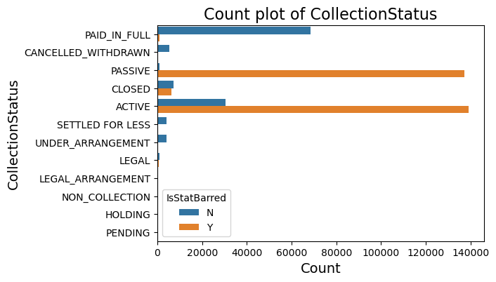
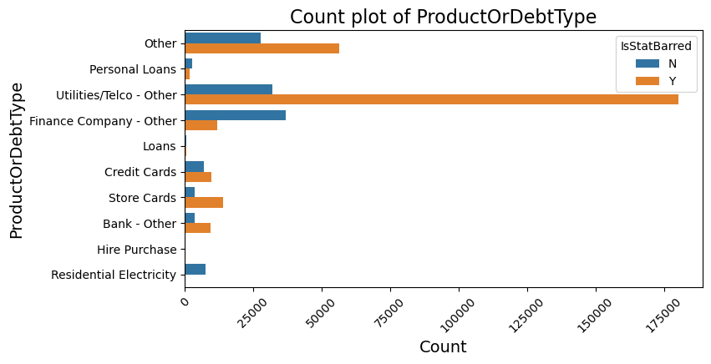
Exploratory Data Analysis
EXPLORATORY DATA ANALYSIS
'ACTIVE' and 'PASSIVE' have a significant number of stat barred entities, while 'LEGAL_ARRANGEMENT' and 'PENDING' have very few.
Utilities/Telco - Other,' have a significant number of stat barred entities ('Y'). In contrast, 'Residential Electricity' has a very low number of stat barred entities ('Y') relative to the total.

Slide 18
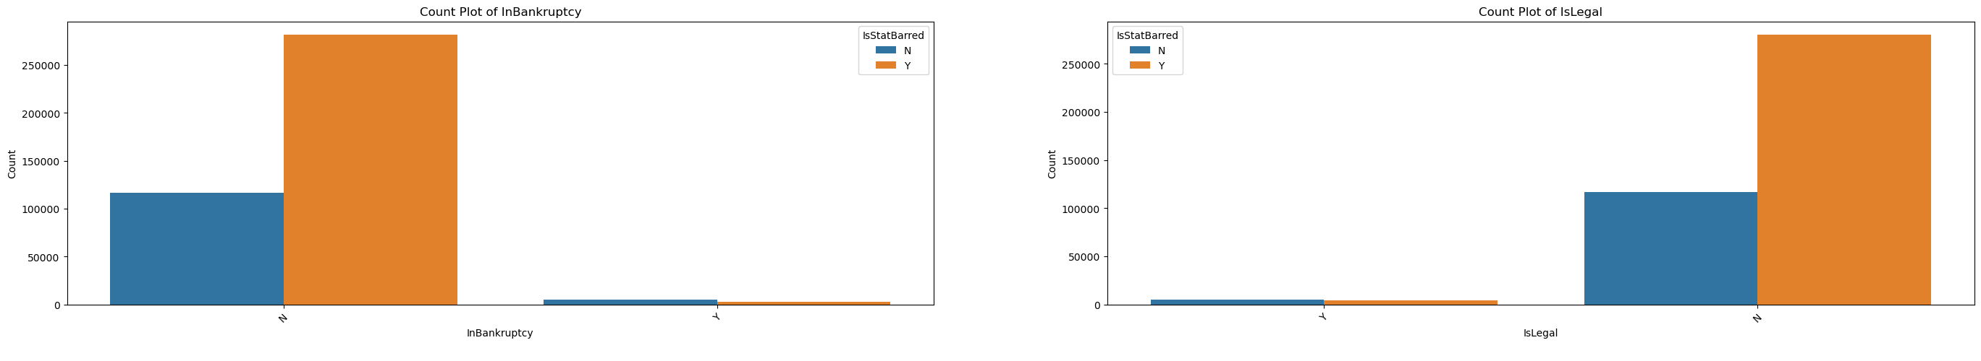
EXPLORATORY DATA ANALYSIS
Distribution of feature with respect to statute barred status
InBankruptcy: A substantial number of entities are not in bankruptcy, regardless of their stat-barred status.
IsLegal: The data shows that no legal action has been taken on a significant number of entities,' and this is true for both stat-barred and non-stat-barred entities.

Slide 19
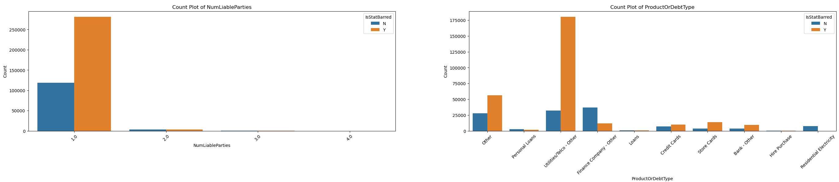
EXPLORATORY DATA ANALYSIS
Distribution of feature with respect to statute barred status
NumLiableParties: The data suggests that a significant number of both stat-barred and non-stat-barred entities have 'NumLiableParties' equal to 1.0, indicating that the majority of entities in the dataset have one liable party.
ProductOrDebtType: For entities that are not stat-barred, 'Finance Company - Other' and 'Utilities/Telco - Other' are the dominant categories, indicating that these types of debt or products are prevalent among non-stat-barred entities.

Slide 20
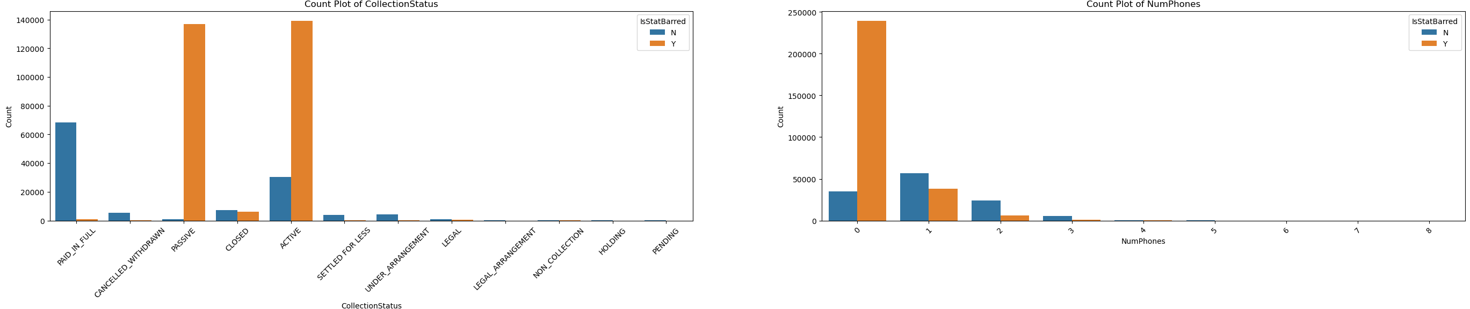
EXPLORATORY DATA ANALYSIS
Distribution of feature with respect to statute barred status
CollectionStatus:For non-stat-barred entities, a notable portion falls under 'PAID_IN_FULL' and 'ACTIVE' statuses. For stat-barred entities, 'ACTIVE' and 'PASSIVE' statuses dominate.
NumPhones:For 'NumPhones,' entities that are not stat-barred ('N') tend to have most common with 1 phone no,.

Slide 21
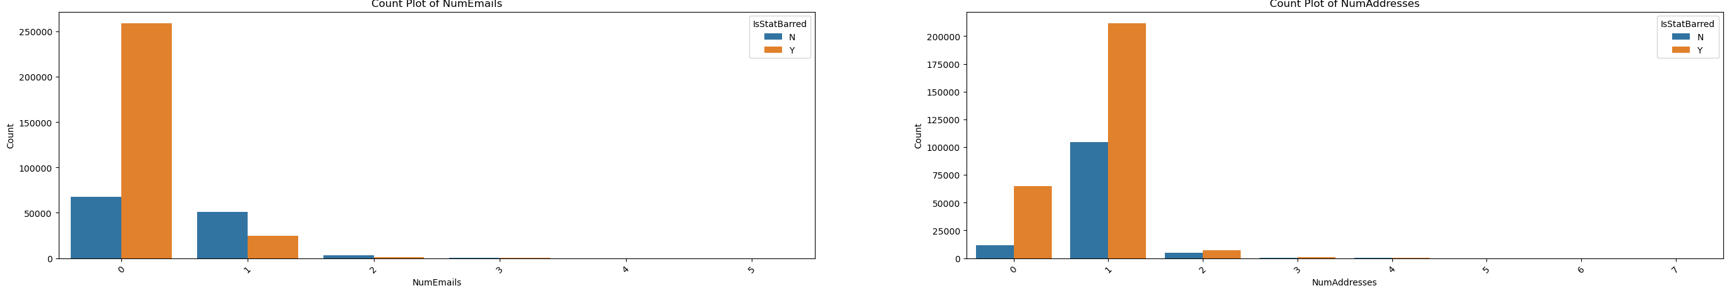
EXPLORATORY DATA ANALYSIS
Distribution of feature with respect to statute barred status
NumEmails:statute barred status entities mostly have 0 email.
NumAddresses:For 'NumAddresses,' entities that are not stat-barred ('N') tend to have addresses, with 1 address being the most common.

Slide 22
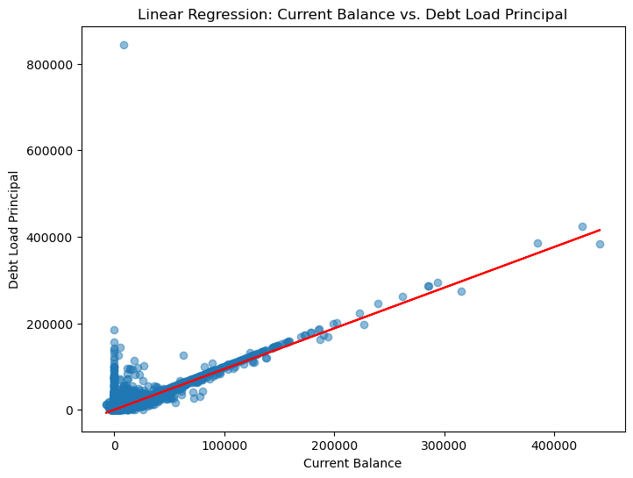
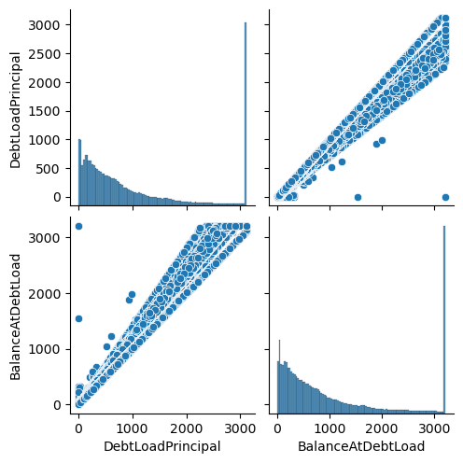
Exploratory Data Analysis
EXPLORATORY DATA ANALYSIS
'There is a linear relation between current balance and debt load principal'
a correlation coefficient of 0.9984 indicates an extremely strong and positive linear relationship between 'DebtLoadPrincipal' and 'BalanceAtDebtLoad.

Slide 23
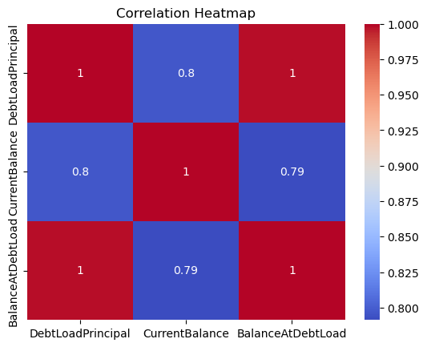
EXPLORATORY DATA ANALYSIS
from the above heatmap we can see that debtload principal,current balance and balance at debt load variables are corelated to eachother.

Slide 24
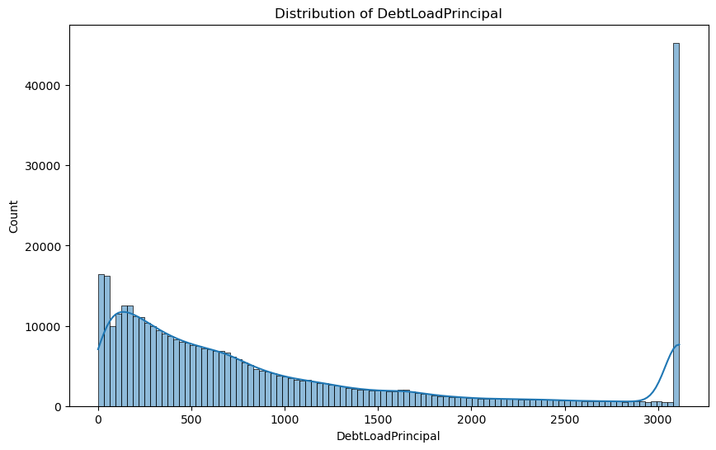
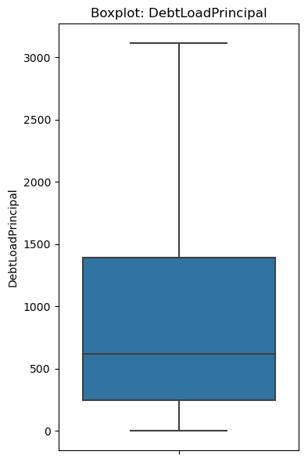
Exploratory Data Analysis
EXPLORATORY DATA ANALYSIS
The mean 'DebtLoadPrincipal' is around 992.68, with a relatively high standard deviation of 984.85, suggesting significant variation.
The minimum value of 0 indicates that some entities have no debt load principal, while the maximum value of 3,113.99 represents the highest observed debt load principal.
the DebtLoadPrincipal histogram is skewed to the right.

Slide 25
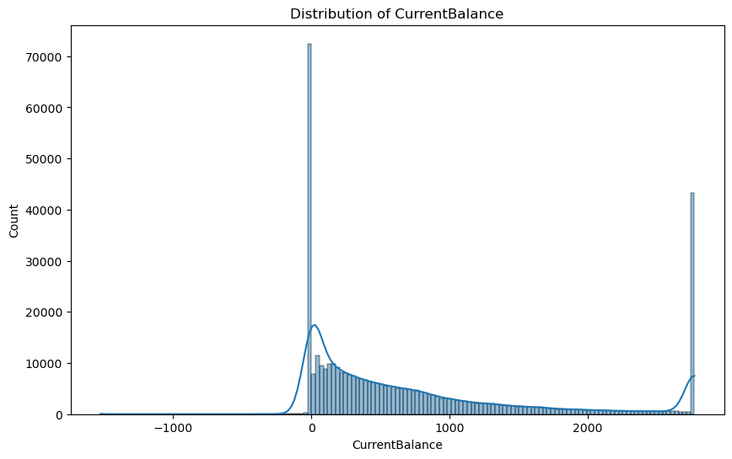
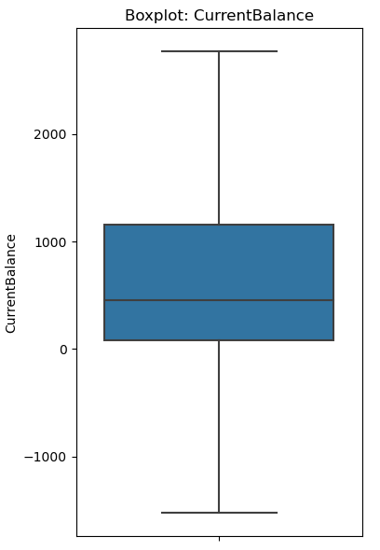
Exploratory Data Analysis
EXPLORATORY DATA ANALYSIS
The mean 'CurrentBalance' is around 798.19, with a standard deviation of 900.03, suggesting significant variation. It's important to note that there are entities with negative current balances, meaning they have more debt or liabilities exceeding their assets.

Slide 26

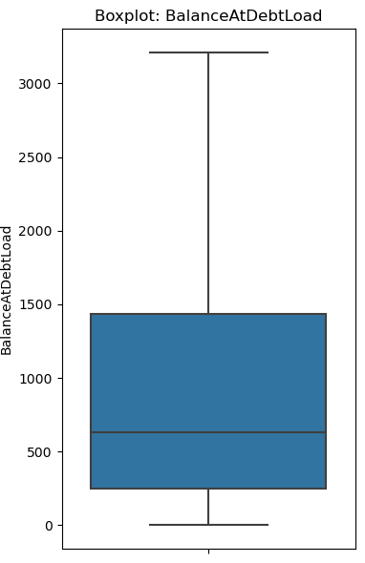
Exploratory Data Analysis
EXPLORATORY DATA ANALYSIS
The mean 'BalanceAtDebtLoad' is around 1022.95, with a standard deviation of 1020.77, indicating significant variability. Some entities have a balance of 0 at the time of debt load, while others have positive balances.
the BalanceAtDebtLoad histogram is skewed to the right.

Slide 27
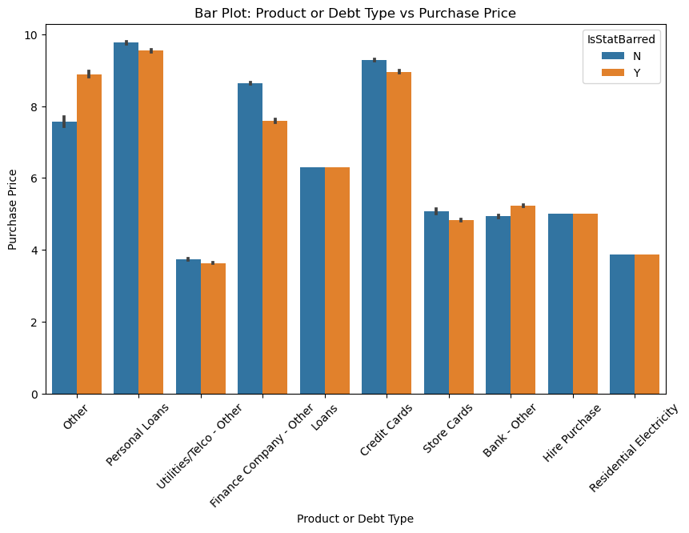
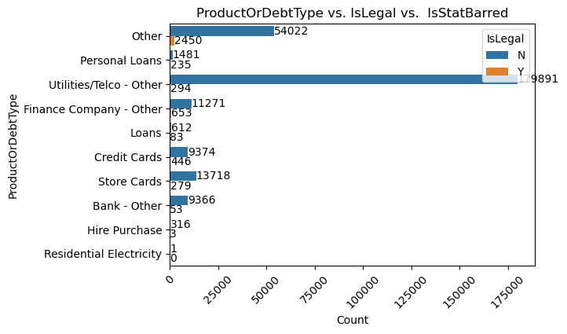
Exploratory Data Analysis
EXPLORATORY DATA ANALYSIS
'Credit Cards' and 'Personal Loans' have relatively higher mean purchase prices compared to other categories.
store Cards and Finance Company and Other, have a significant number of legal entities ('IsLegal_Y'). In contrast, 'Residential Electricity' has a very low number of legal entities relative to the total.

Slide 28
DATA PREPROCESSING
Data Encoding
Most machine learning algorithms cannot operate on categorical data directly. They require all input variables and output variables to be numeric. Most algorithm’s performances vary based on which encoding method is used.
We will use label encoding on this dataset.
Data Splitting:
Data splitting is a crucial step in machine learning to evaluate and validate models effectively.
Splitting data into train and test sets.
Data Scaling
After splitting the dataset into train and test performed Data normalization or scaling to Standardize numeric features.
Data normalization or scaling is a crucial preprocessing step in machine learning to ensure that the features in your dataset have similar scales or ranges.

Slide 29

Model Selection
MODEL SELECTION
We are now ready to apply machine learning algorithms to our prepared data matrices.
There are many machine learning algorithms to experiment with when you are working on a classification problem.
You never know which classification model would work the best for you beforehand. So, we will experiment with a couple of classification models and check which model performs the best.
Here we are using the following models on our dataset.
AdaBoost
Gradient Boosting
Logistic Regression
Random Forest Classifier
KNN
XGboost

Slide 30
MODEL TRAINING
Now we will plot the table comparing accuracy of each model. .
Plotting accuracy ,F1 score,AUC Table for models using label encoding.
XGBClassifier model is giving the highest accuracy,f1 score and AUC.
after applying hyperparameter tuning on xgb classifier model our accuracy increses to 97.6% . so we for our final model we are going to use xgb classifier with fine tuning.
MODEL | ACCURACY | F1-SCORE | AUC
RANDOM FOREST | 0.970 | 0.978 | 0.993
LOGISTIC REGRESSION | 0.835 | 0.888 | 0.872
XG BOOST | 0.975 | 0.982 | 0.995
KNN | 0.954 | 0.967 | 0.975
GRADIENT BOOSTING | 0.972 | 0.980 | 0.994
Ada BOOST | 0.958 | 0.971 | 0.990

Slide 31
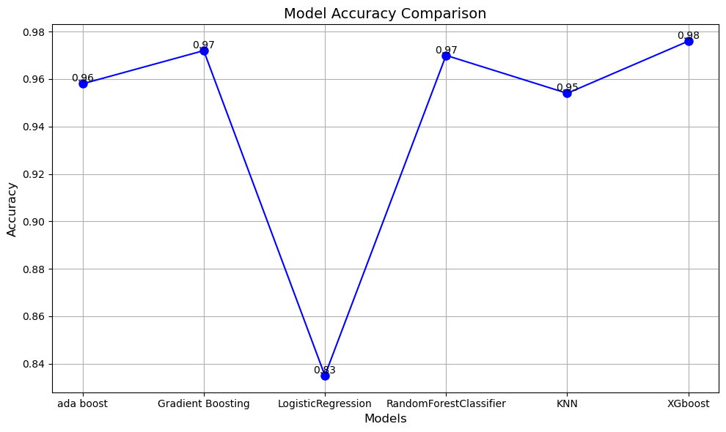
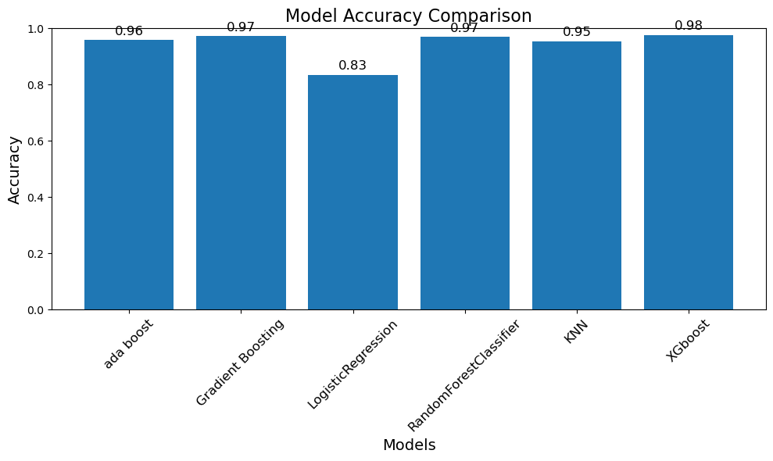
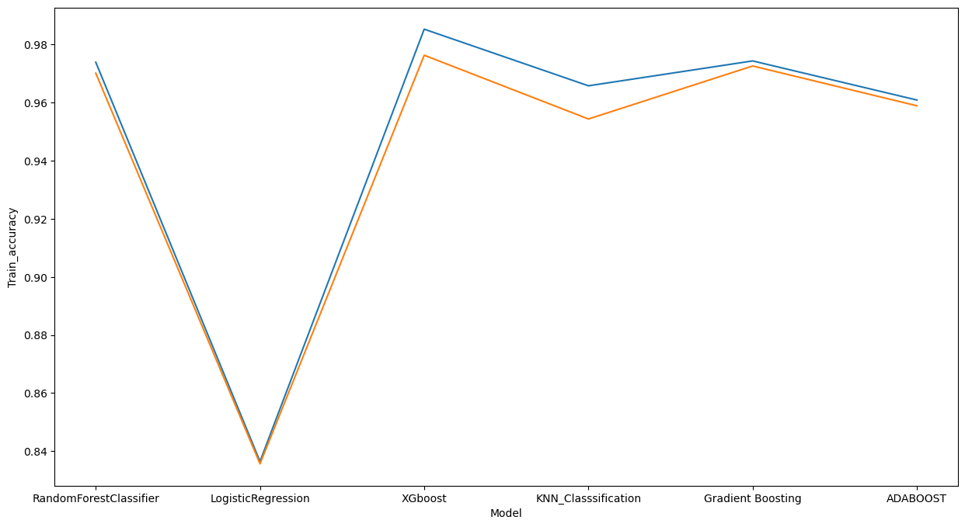
MODEL COMPARISION

Slide 32
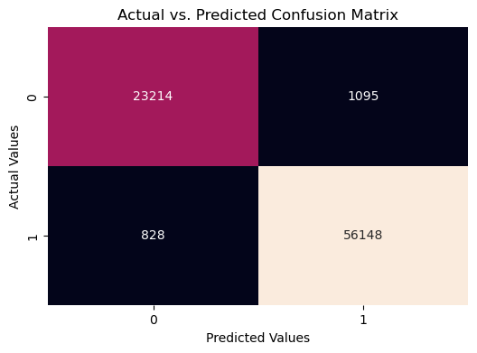
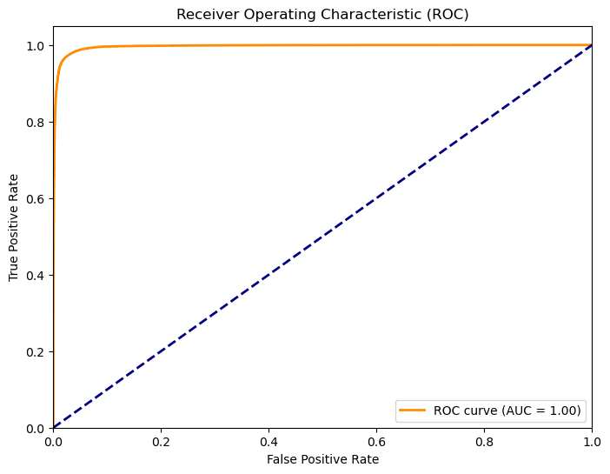
MODEL EVALUATION
The Receiver Operating Characteristic (ROC) curve illustrates the trade-off between the true positive rate (sensitivity) and false positive rate (1-specificity) across different thresholds. With an Area Under the Curve (AUC) of 0.996, our model demonstrates reasonably good discriminative power.
The confusion matrix provides an insight into our model's ability to correctly classify positive and negative instances.

Slide 33
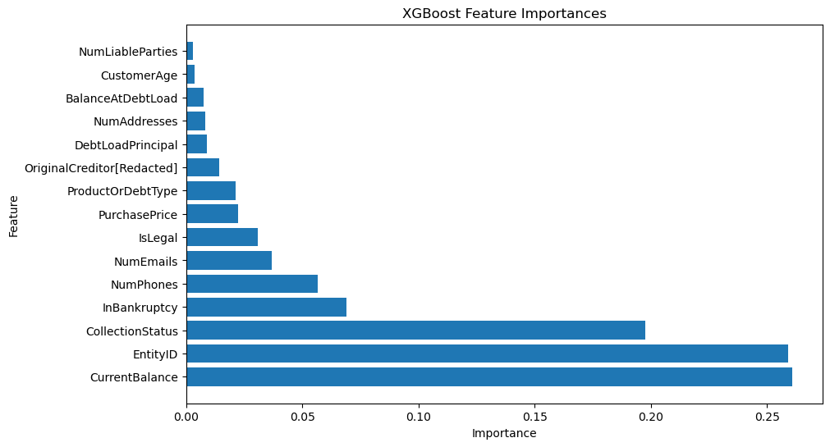
FEATURE IMPORTANCE
Based on the summary plot, it shows that current balance , entityid and collection status give the most impact on the model decision.

Slide 34
CONCLUSION
CONCLUSION
Model Performance: We explored various machine learning algorithms, including Gradient Boosting, XGBoost, Random Forest, KNN, Logistic Regression, and AdaBoost. Among these, XGBoost yielded the highest accuracy of approximatly 98% on our dataset.
Data Preprocessing: We employed Label encoding to transform categorical variables, making them compatible with our machine learning models.
Model Evaluation: We employed two key evaluation metrics: the Confusion Matrix and the ROC Curve. The Confusion Matrix revealed our model's ability to classify true positives, true negatives, false positives, and false negatives. The ROC Curve, with an AUC of 0.99, demonstrated our model's discrimination capability.
Continual Improvement: While achieving a 98% accuracy is promising, there's room for improvement. We can further fine-tune hyperparameters, explore feature engineering techniques, or consider ensemble methods to enhance model performance.
Real-World Applicability: It's important to note that the success of our model in a real-world context extends beyond accuracy. Factors such as interpretability, scalability, and deployment feasibility should also be considered to ensure practical usability.

Slide 35
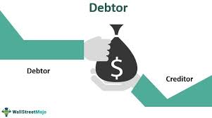

THANK YOU

